Slide 1
Interim Results
Master Thesis: Sex Differences in Acute Neglect

Slide 2
Summary Stats: Patient Population

Slide 4
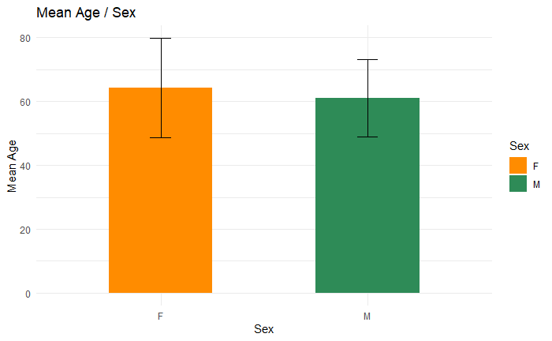

Slide 5
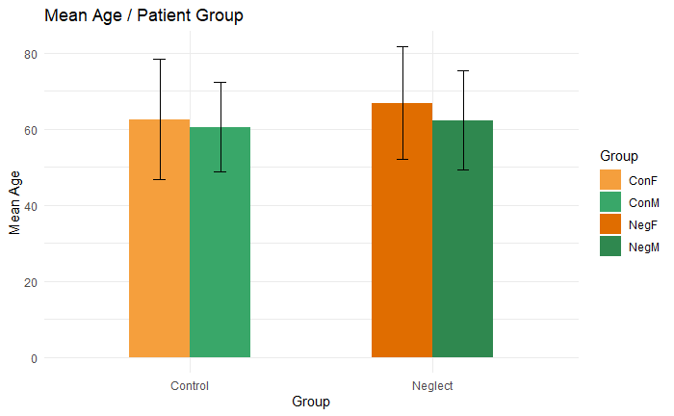

Slide 6
Summary Stats: Stroke Aetiology

Slide 8
Neuroimaging: Lesion Overlay Plots

Slide 9
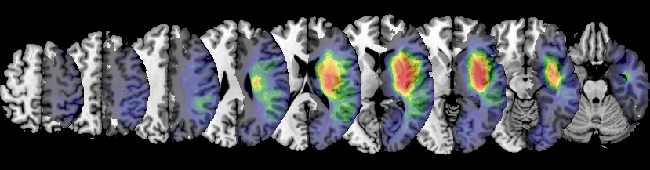
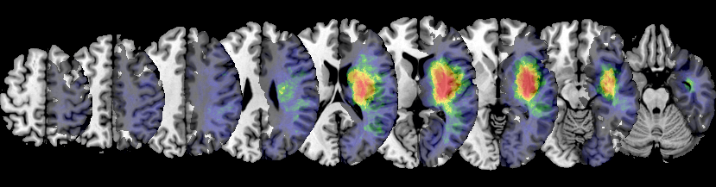
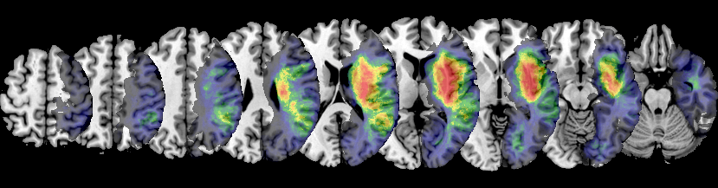
A
L
L
P
A
T
I
E
N
T
S
Male Female All

Slide 10
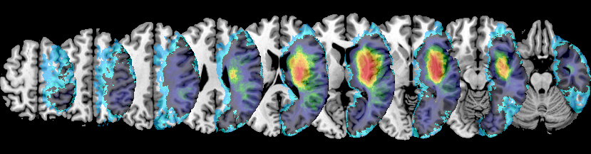
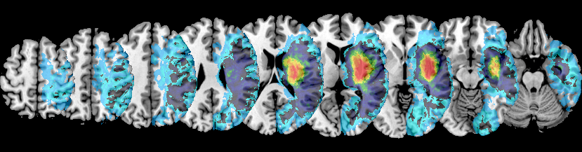
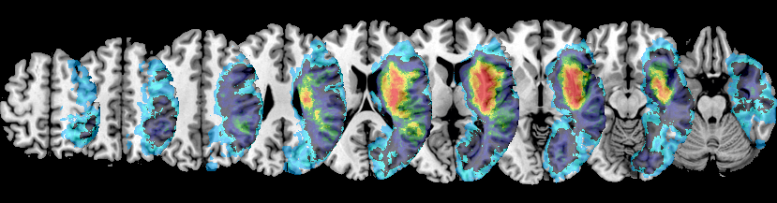
A
L
L
P
A
T
I
E
N
T
S
Male Female All

Slide 11
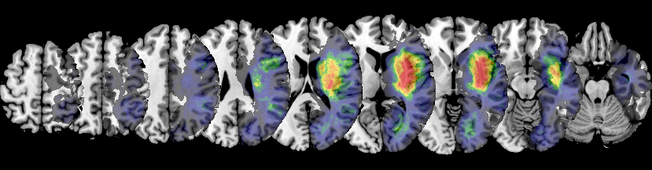
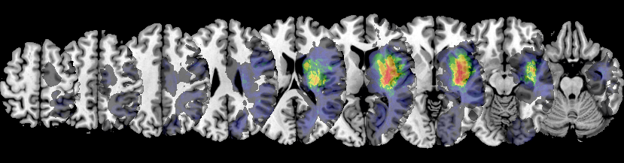
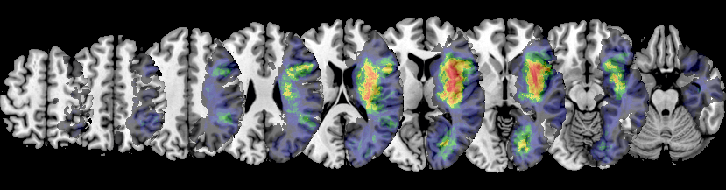
C
O
N
T R O L
Male Female All

Slide 12
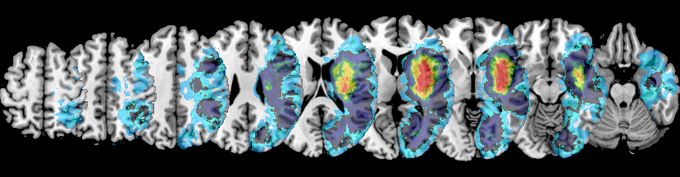
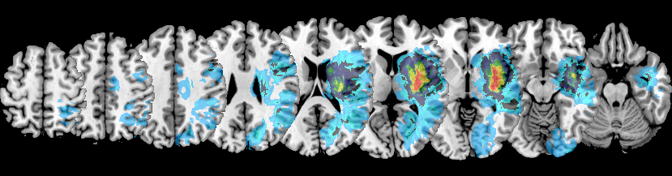
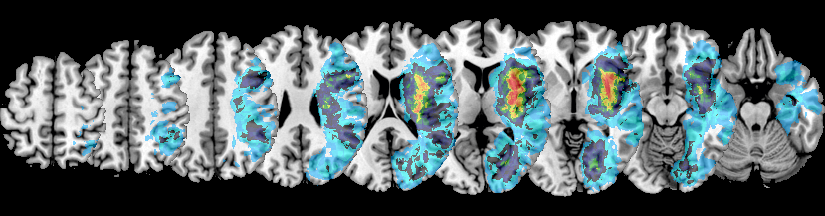
C
O N T R O L
Male Female All

Slide 13
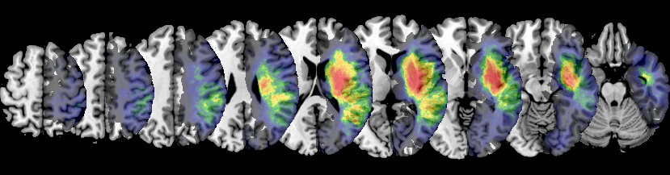
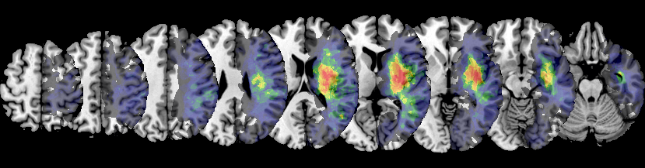
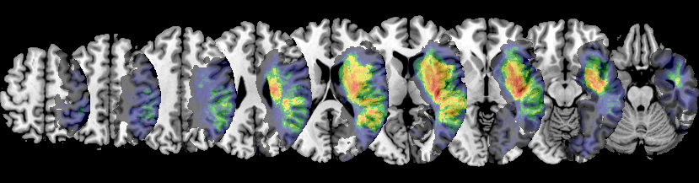
N E G L E C T
Male Female All

Slide 14
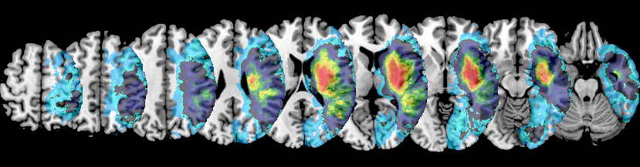
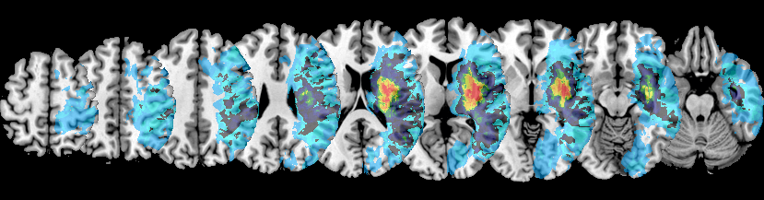
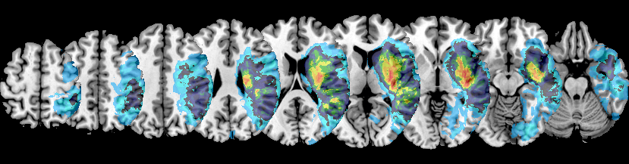
N E G L E C T
Male Female All

Slide 15
Neuroimaging: Lesion Subtraction Plots

Slide 16
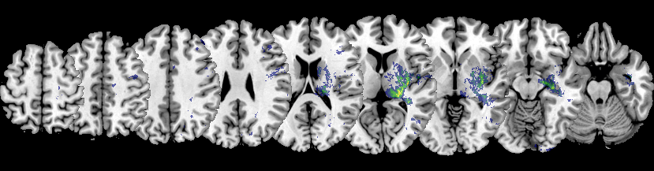
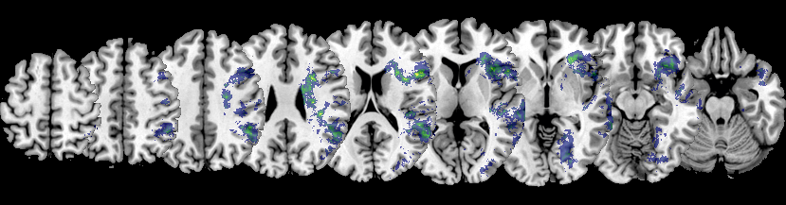
Female
A
L
L
P
A
T
I
E
N
T
S
allF - allM
Male
allM - allF

Slide 17
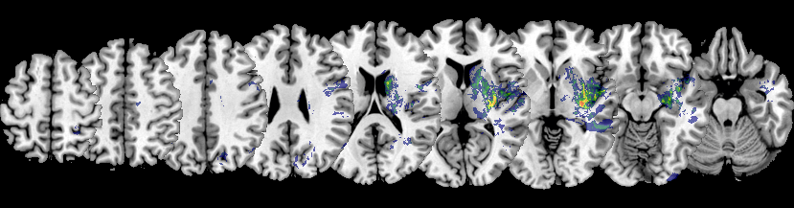
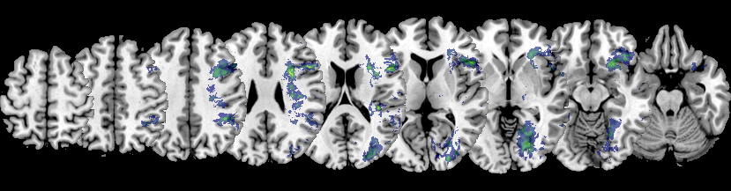
Female
C O N T R O L
ConF - ConM
Male
ConM - ConF

Slide 18
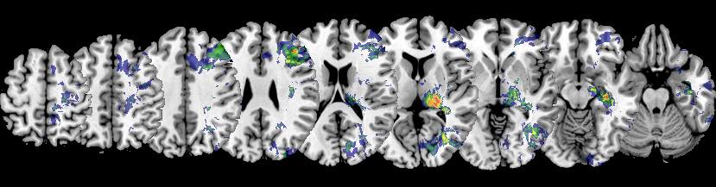
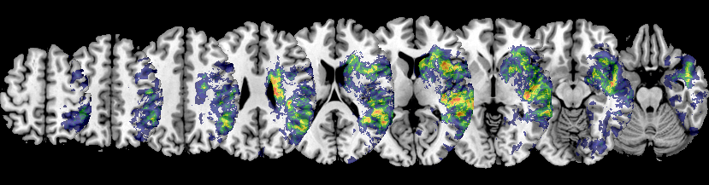
Female
N E G L E C T
NegF - NegM
Male
NegM - NegF

Slide 19
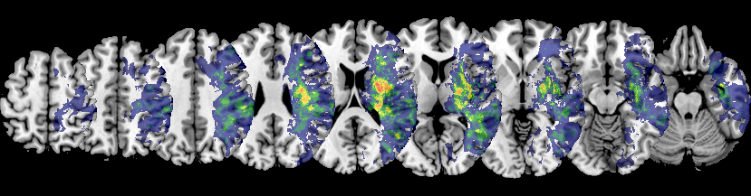
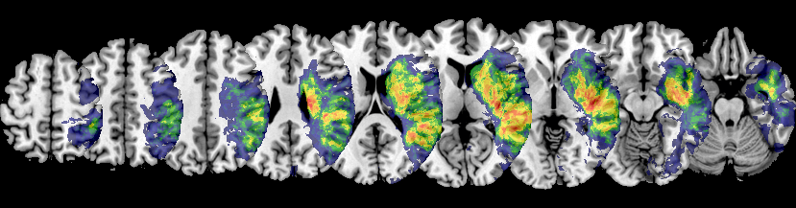
Female
N E G L E C T
NegF - ConF
Male
NegM - ConM

Slide 20
Neuroimaging: Univariate VLBM

Slide 21
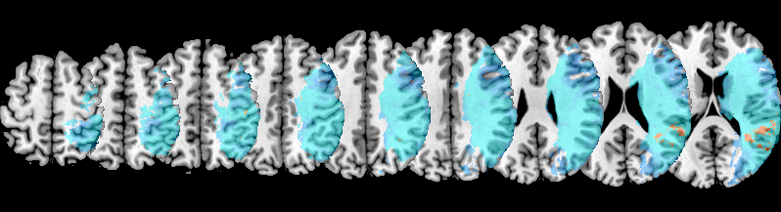
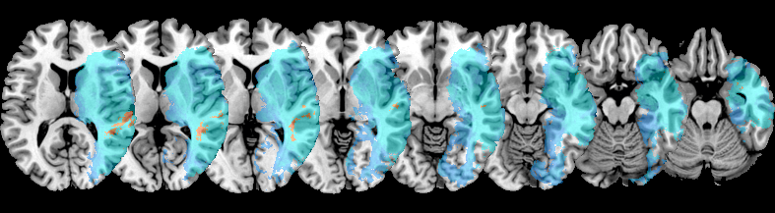
A
L
L
P
A
T
I
E
N
T
S

Slide 22
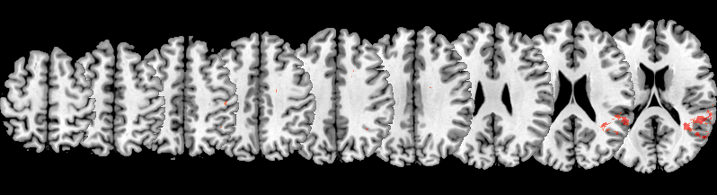
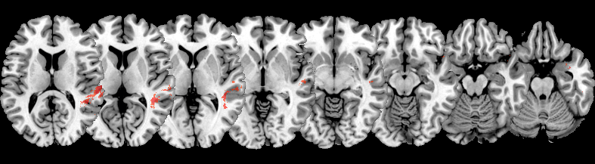
A
L
L
P
A
T
I
E
N
T
S

Slide 23
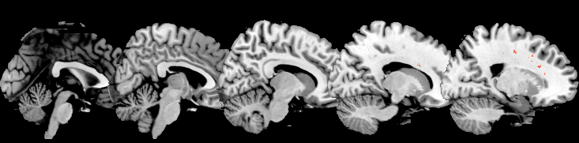
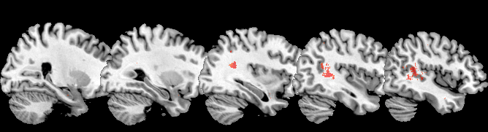
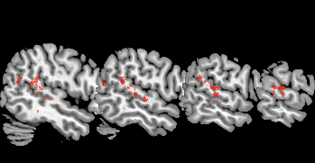
A
L
L
P
A
T
I
E
N
T
S

Slide 24
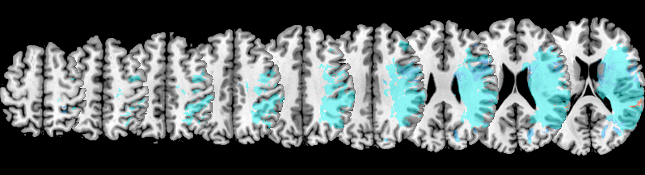
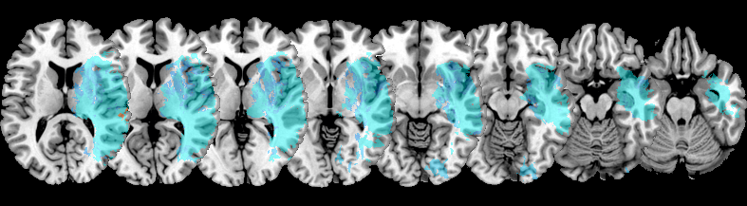
F E M A L E

Slide 25
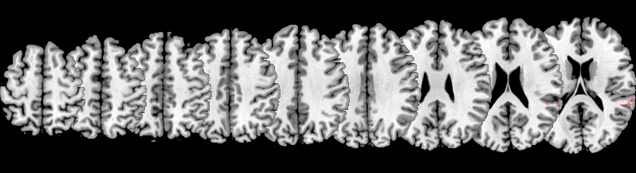
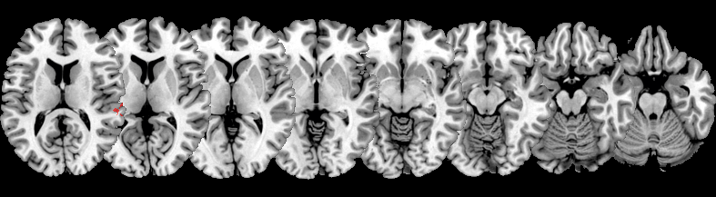
F E M A L E

Slide 26
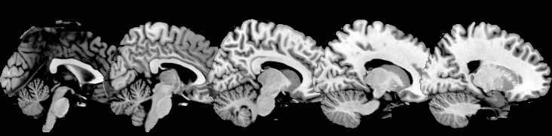
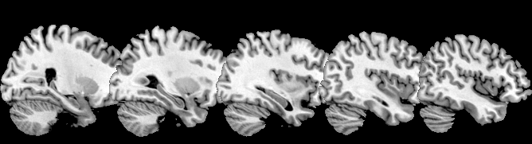
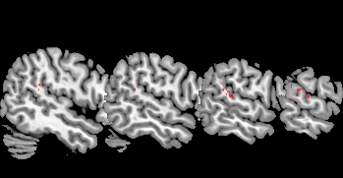
F E M A L E

Slide 27
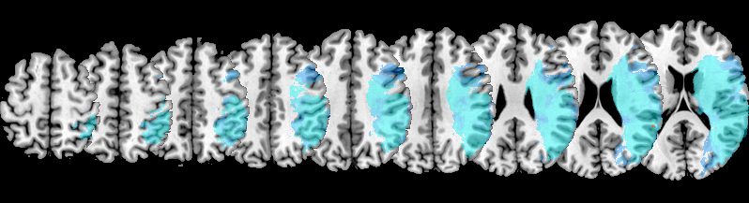
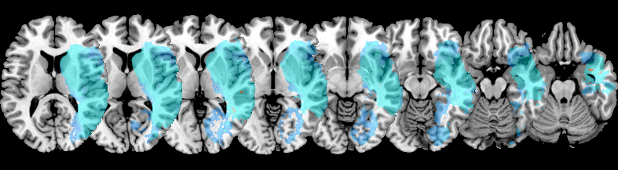
M A L E

Slide 28
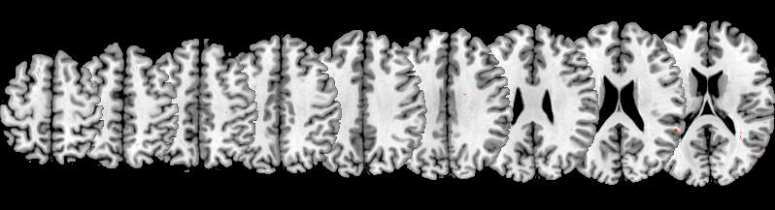
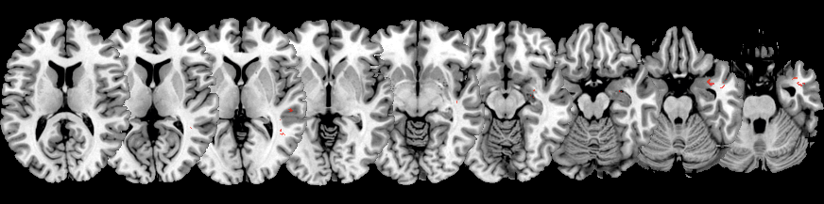
M A L E

Slide 29
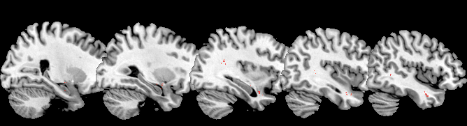
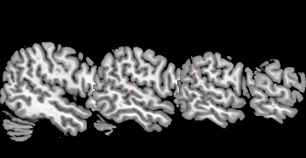
M A L E

Slide 30

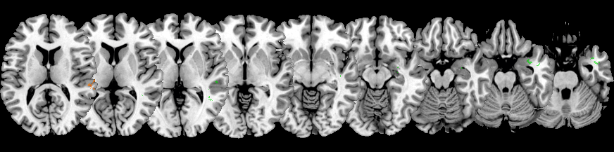
F E M A L E / M A L E

Slide 31
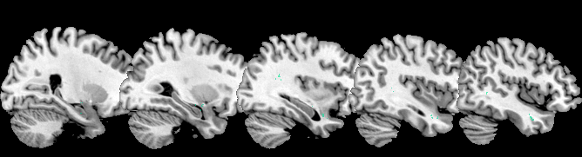

F E M A L E / M A L E

Slide 32
Neuroimaging: Disconnection Plots
Overlay & Subtraction, created with MRIcron

Slide 33



A
L
L
P
A
T
I
E
N
T
S
Male Female All

Slide 34


Female
A
L
L
P
A
T
I
E
N
T
S
allF - allM
Male
allM - allF

Slide 35



C O N T R O L
Male Female All

Slide 36


Female
C O N T R O L
conF - conM
Male
conM - conF

Slide 37

Neg - Con

Slide 38



N E G L E C T
Male Female All

Slide 39


Female
N E G L E C T
negF - negM
Male
negM - negF

Slide 40
Neuroimaging: Disconnection Plots
Overlay & Average; created with MATLAB

Slide 41


Average all
overlay all

Slide 42


Average Disconnection
A
L
L
P
A
T
I
E
N
T
S
Male Female All

Slide 43



Overlay Disconnection
A
L
L
P
A
T
I
E
N
T
S
Male Female All

Slide 44



Overlay Disconnection (≥50%)
A
L
L
P
A
T
I
E
N
T
S
Male Female All

